Slide 1
CSS – Continued..
Instructor: Manu Peethambar
E-mail: cm13055@umbc.edu
Telegram handle: @manupeethambar888
Slides: https://github.com/manupeethambar888/webdev

Slide 2
CSS 2D Transforms
CSS transforms allow you to translate, rotate, scale, and skew elements.
https://www.w3schools.com/css/css3_2dtransforms.asp
CSS 3D Transforms
CSS allows you to format your elements using 3D transformations.
https://www.w3schools.com/css/css3_3dtransforms.asp
CSS Transitions
CSS transitions allows you to change property values smoothly (from one value to another), over a given duration.
https://www.w3schools.com/css/css3_transitions.asp

Slide 3
CSS Animations
CSS animations allows animation of most HTML elements without using JavaScript or Flash!
https://www.w3schools.com/css/css3_animations.asp
CSS Box Sizing
The CSS box-sizing property allows us to include the padding and border in an element's total width and height.
https://www.w3schools.com/css/css3_box-sizing.asp
CSS Media Queries
Media queries in CSS3 extended the CSS2 media types idea: Instead of looking for a type of device, they look at the capability of the device.
https://www.w3schools.com/css/css3_mediaqueries.asp

Slide 4
Project – My Website
Copy the HTML in the link below:
https://www.w3schools.com/css/tryit.asp?filename=trycss_website_layout_blog
Add the HTML inside the div with id container.
Add the styles in the project.css file.
Check the output on your browser.

Slide 5
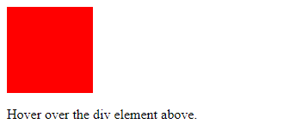
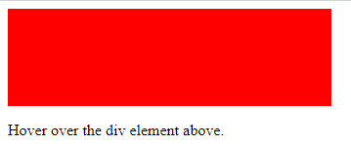
Assignment 12 due – 7/12/2018
Create a sample HTML file to get the output as below:
Using the transition shorthand property, specify width changes for the <div> element should have:
"2" second duration, "ease-in-out" speed curve, and a "0.5" second delay before starting.
Save this as “assignment12.html” in Homework folder in your repository “Assignments_yourname”.
Commit and push the changes to the repository.

